Slide 1
Advanced Image Analysis
a.a. 2017-2018, 2nd semester
Module 6
Optical Flow
Alessandro Bria
Contract Professor
and Post-doc Researcher
email: a.bria@unicas.it

Slide 2
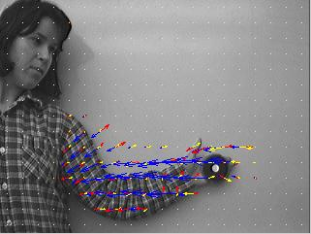
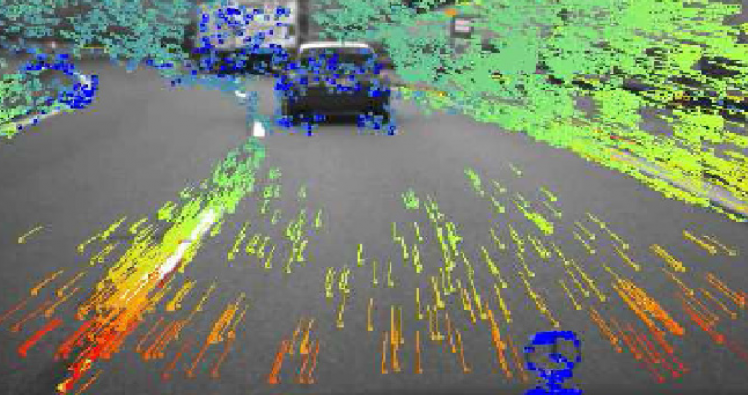
What is Optical Flow?
general definition:
the pattern of apparent motion of objects in a visual scene caused by the relative motion between an observer and the scene objects
image definition:
the pattern of apparent motion of image objects between two consecutive frames caused by the movement of object or camera
we will process an image sequence
a 2D vector field where each vector is a displacement vector showing the movement of points from first frame to second

Slide 3
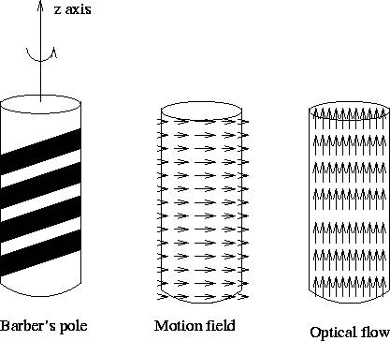
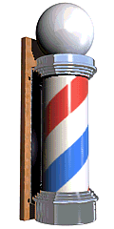
Optical Flow $≠$ Motion Field
Motion Field
projection of a 3D relative velocity vectors onto the image plane
most of the time is what we want, but optical flow is what we can actually measure

Slide 4
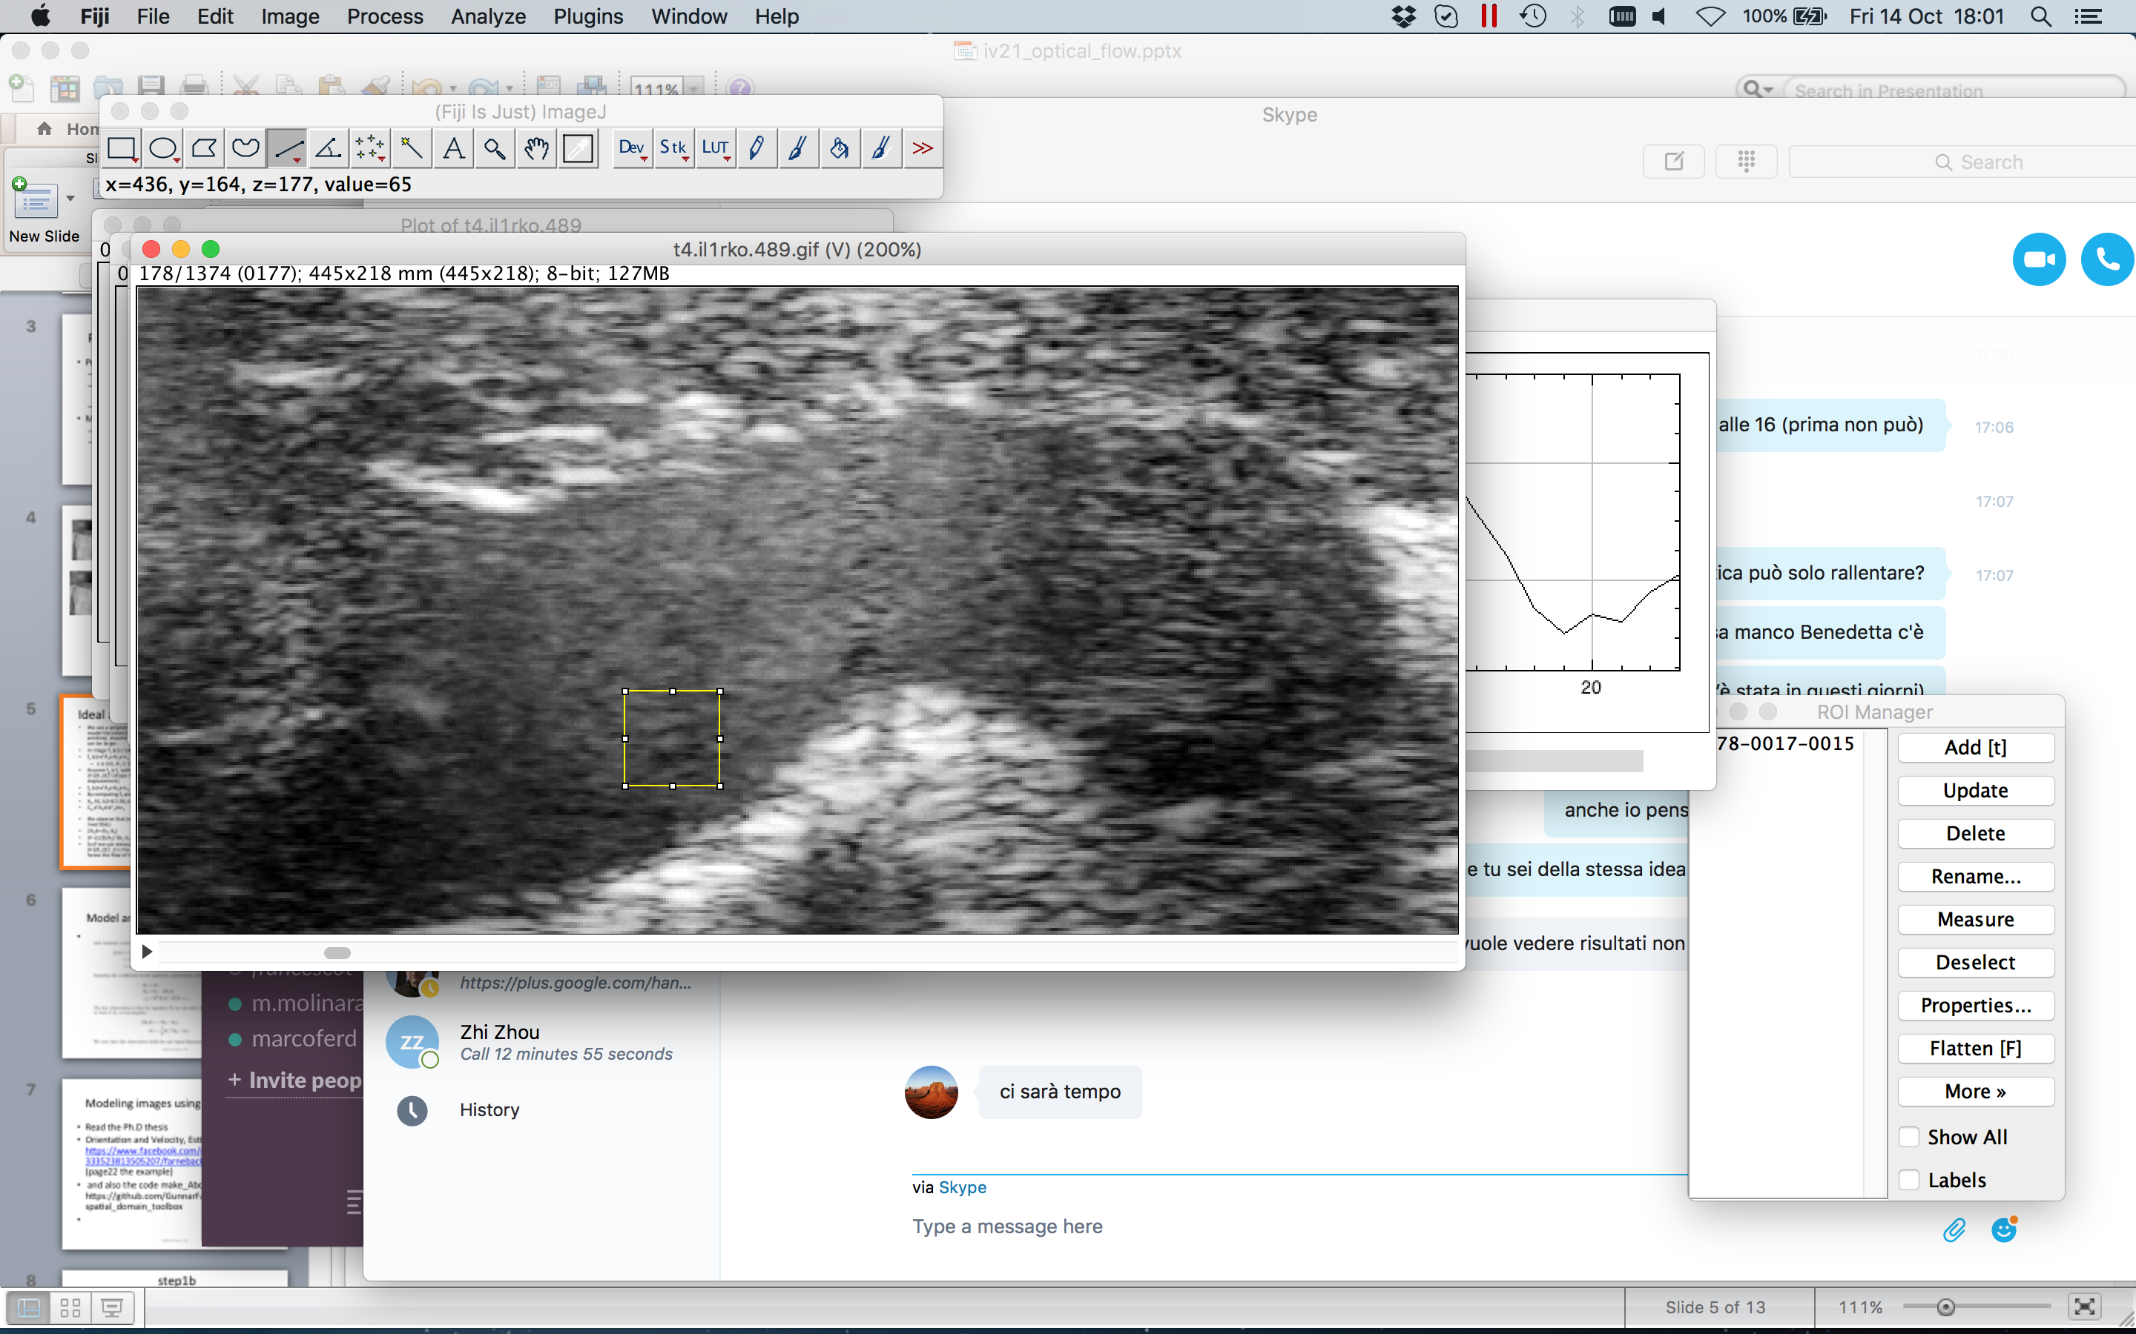
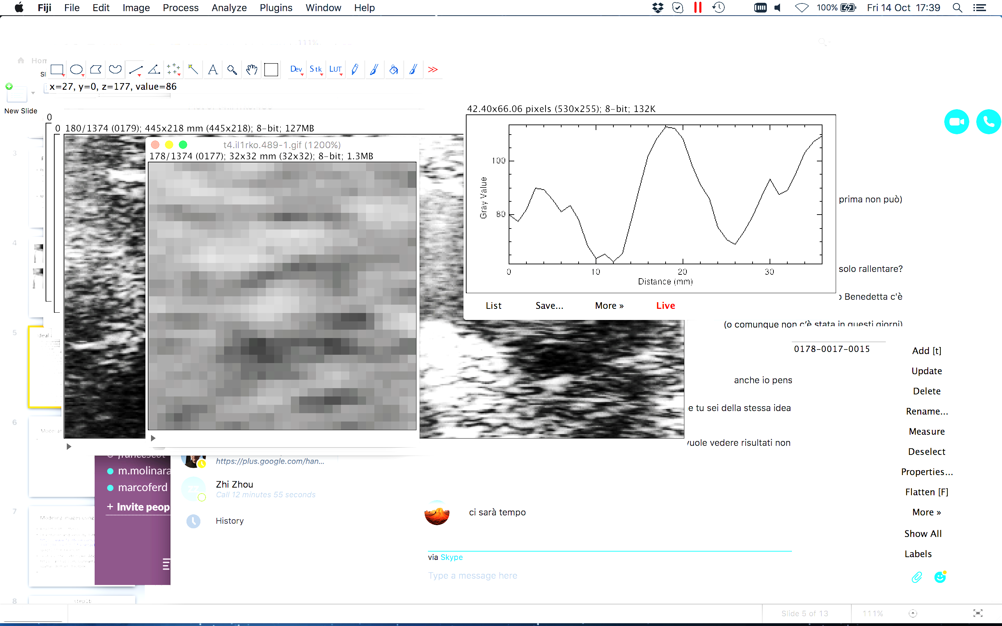
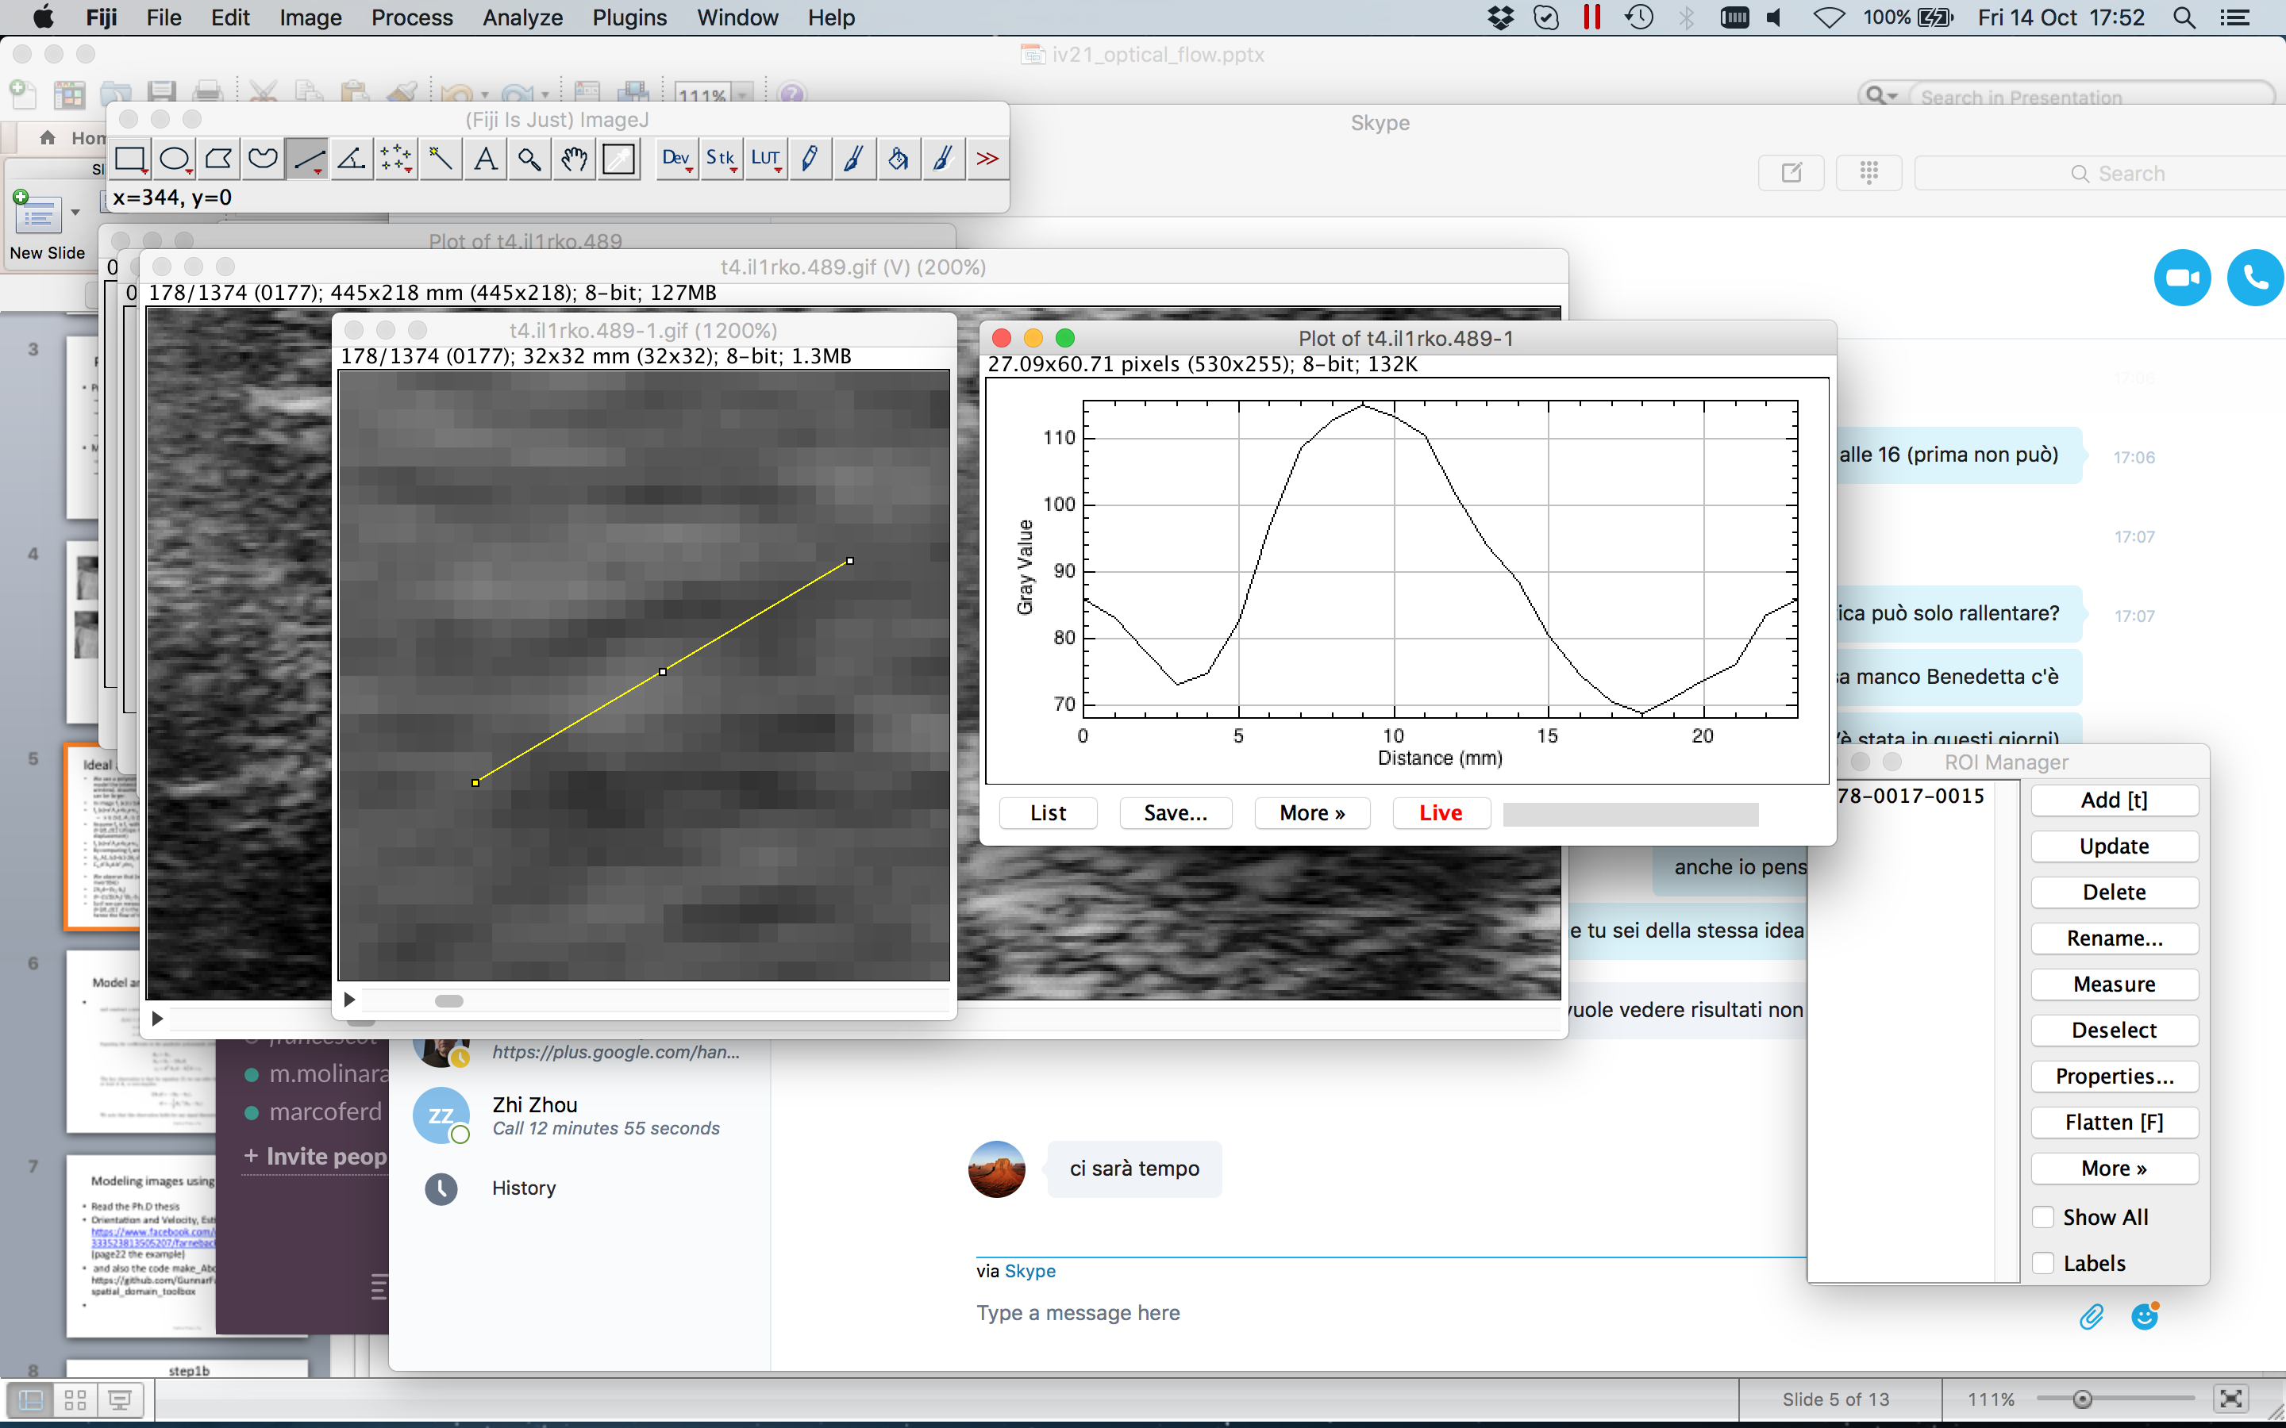
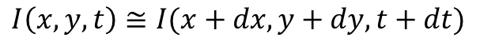
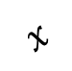
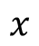
Assumptions
brightness constancy
image intensities do not change significatively although their location may change
spatial coherence
neighboring points belong to the same surface and hence have similar motions
temporal persistence
the image motion of a surface patch changes gradually over time
$$I\left(x,y,t\right)≅I(x+dx, y+dy,t+dt)$$
ultrasound image of aorta
$$x$$
a blood cell
$$x$$

Slide 5

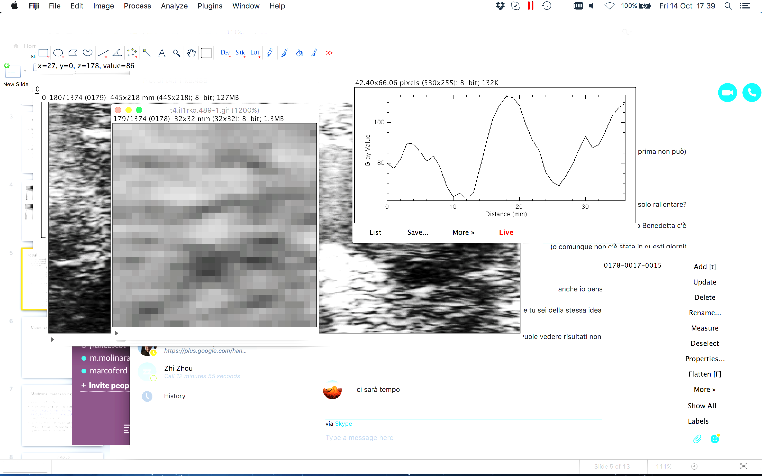


Assumptions
brightness constancy
image intensities do not change significatively although their location may change
spatial coherence
neighboring points belong to the same surface and hence have similar motions
temporal persistence
the image motion of a surface patch changes gradually over time
$$I\left(x,y,t\right)≅I(x+dx, y+dy,t+dt)$$
ultrasound image of aorta
$$x$$
a blood cell
$$x$$
$$dx$$

Slide 6
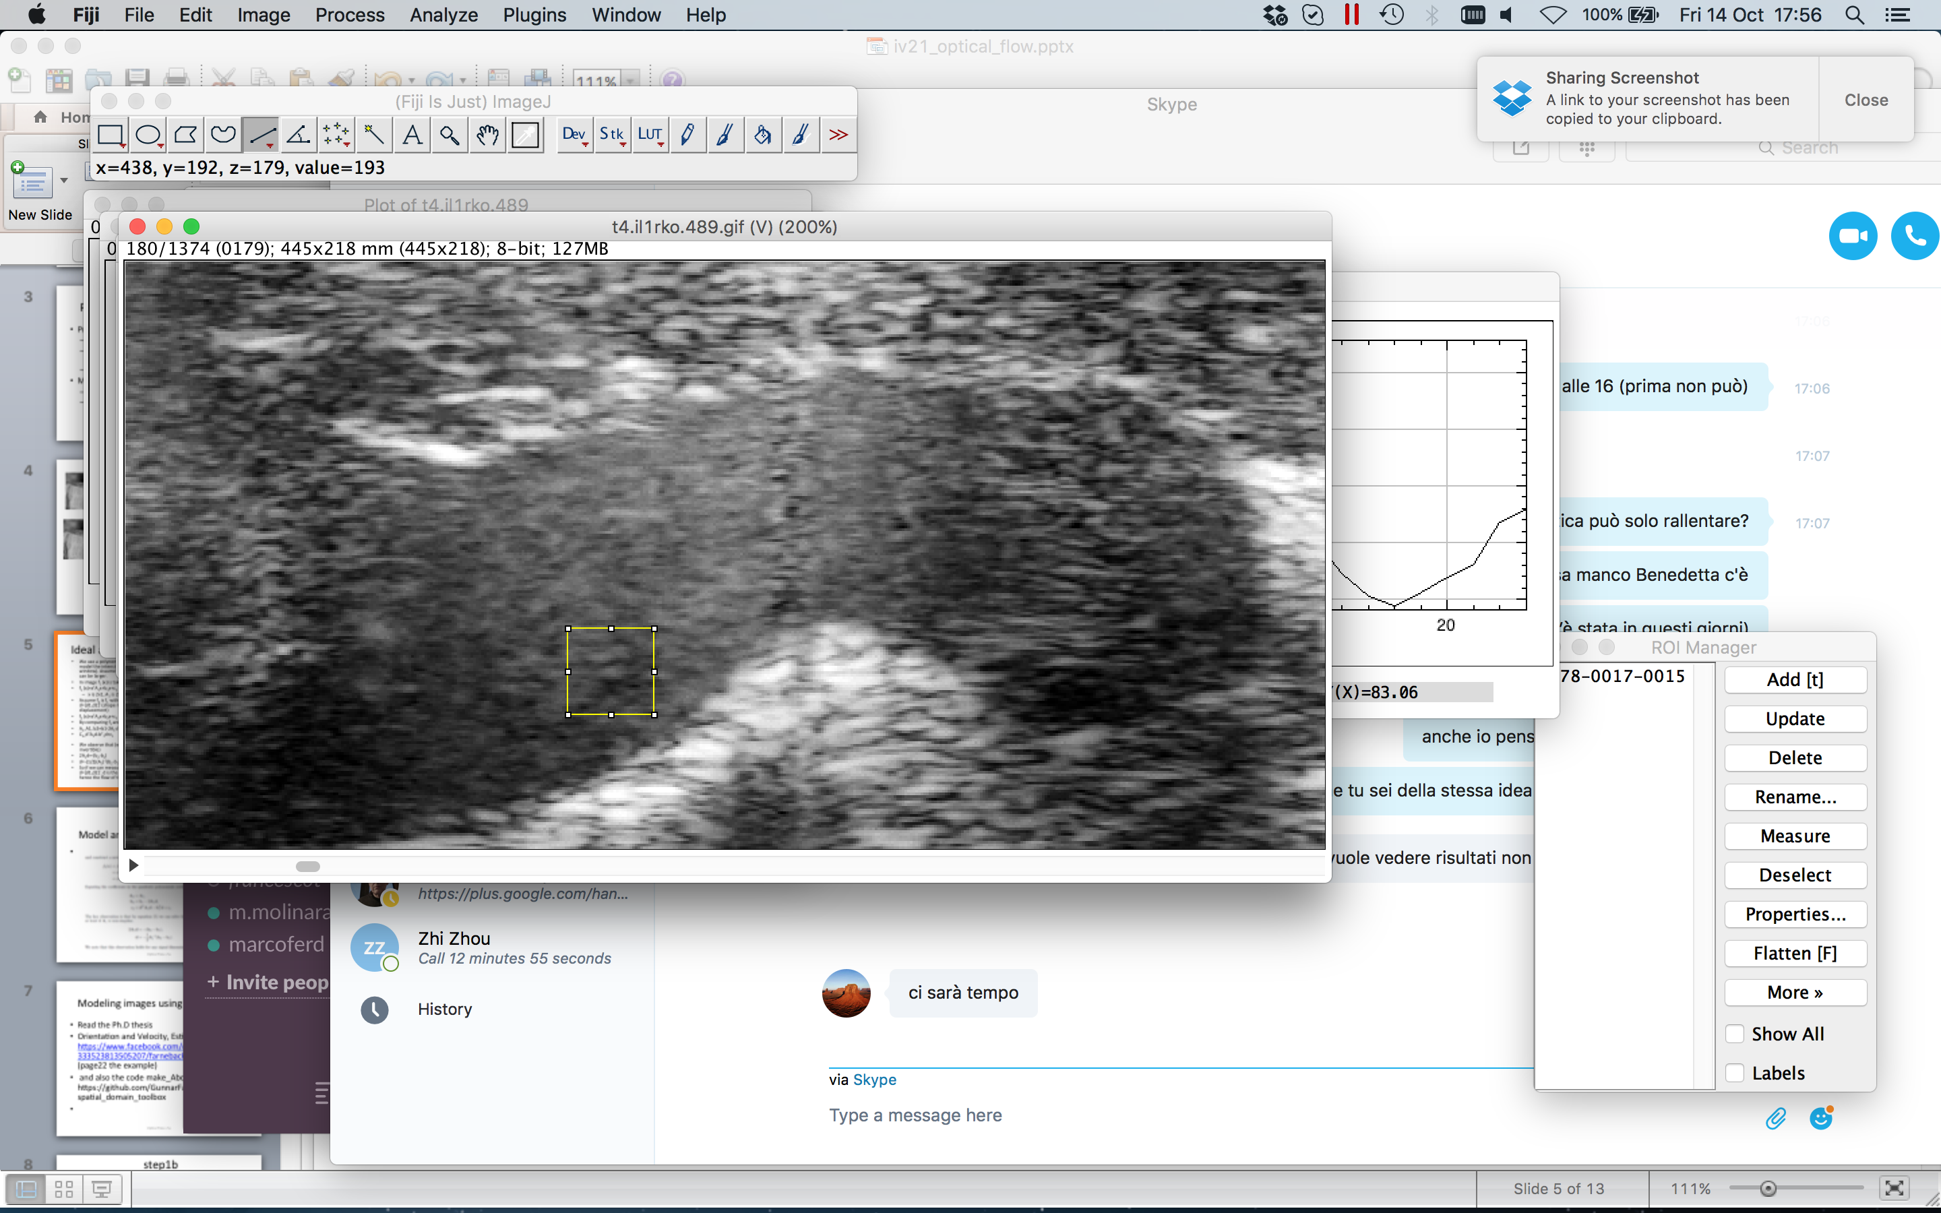
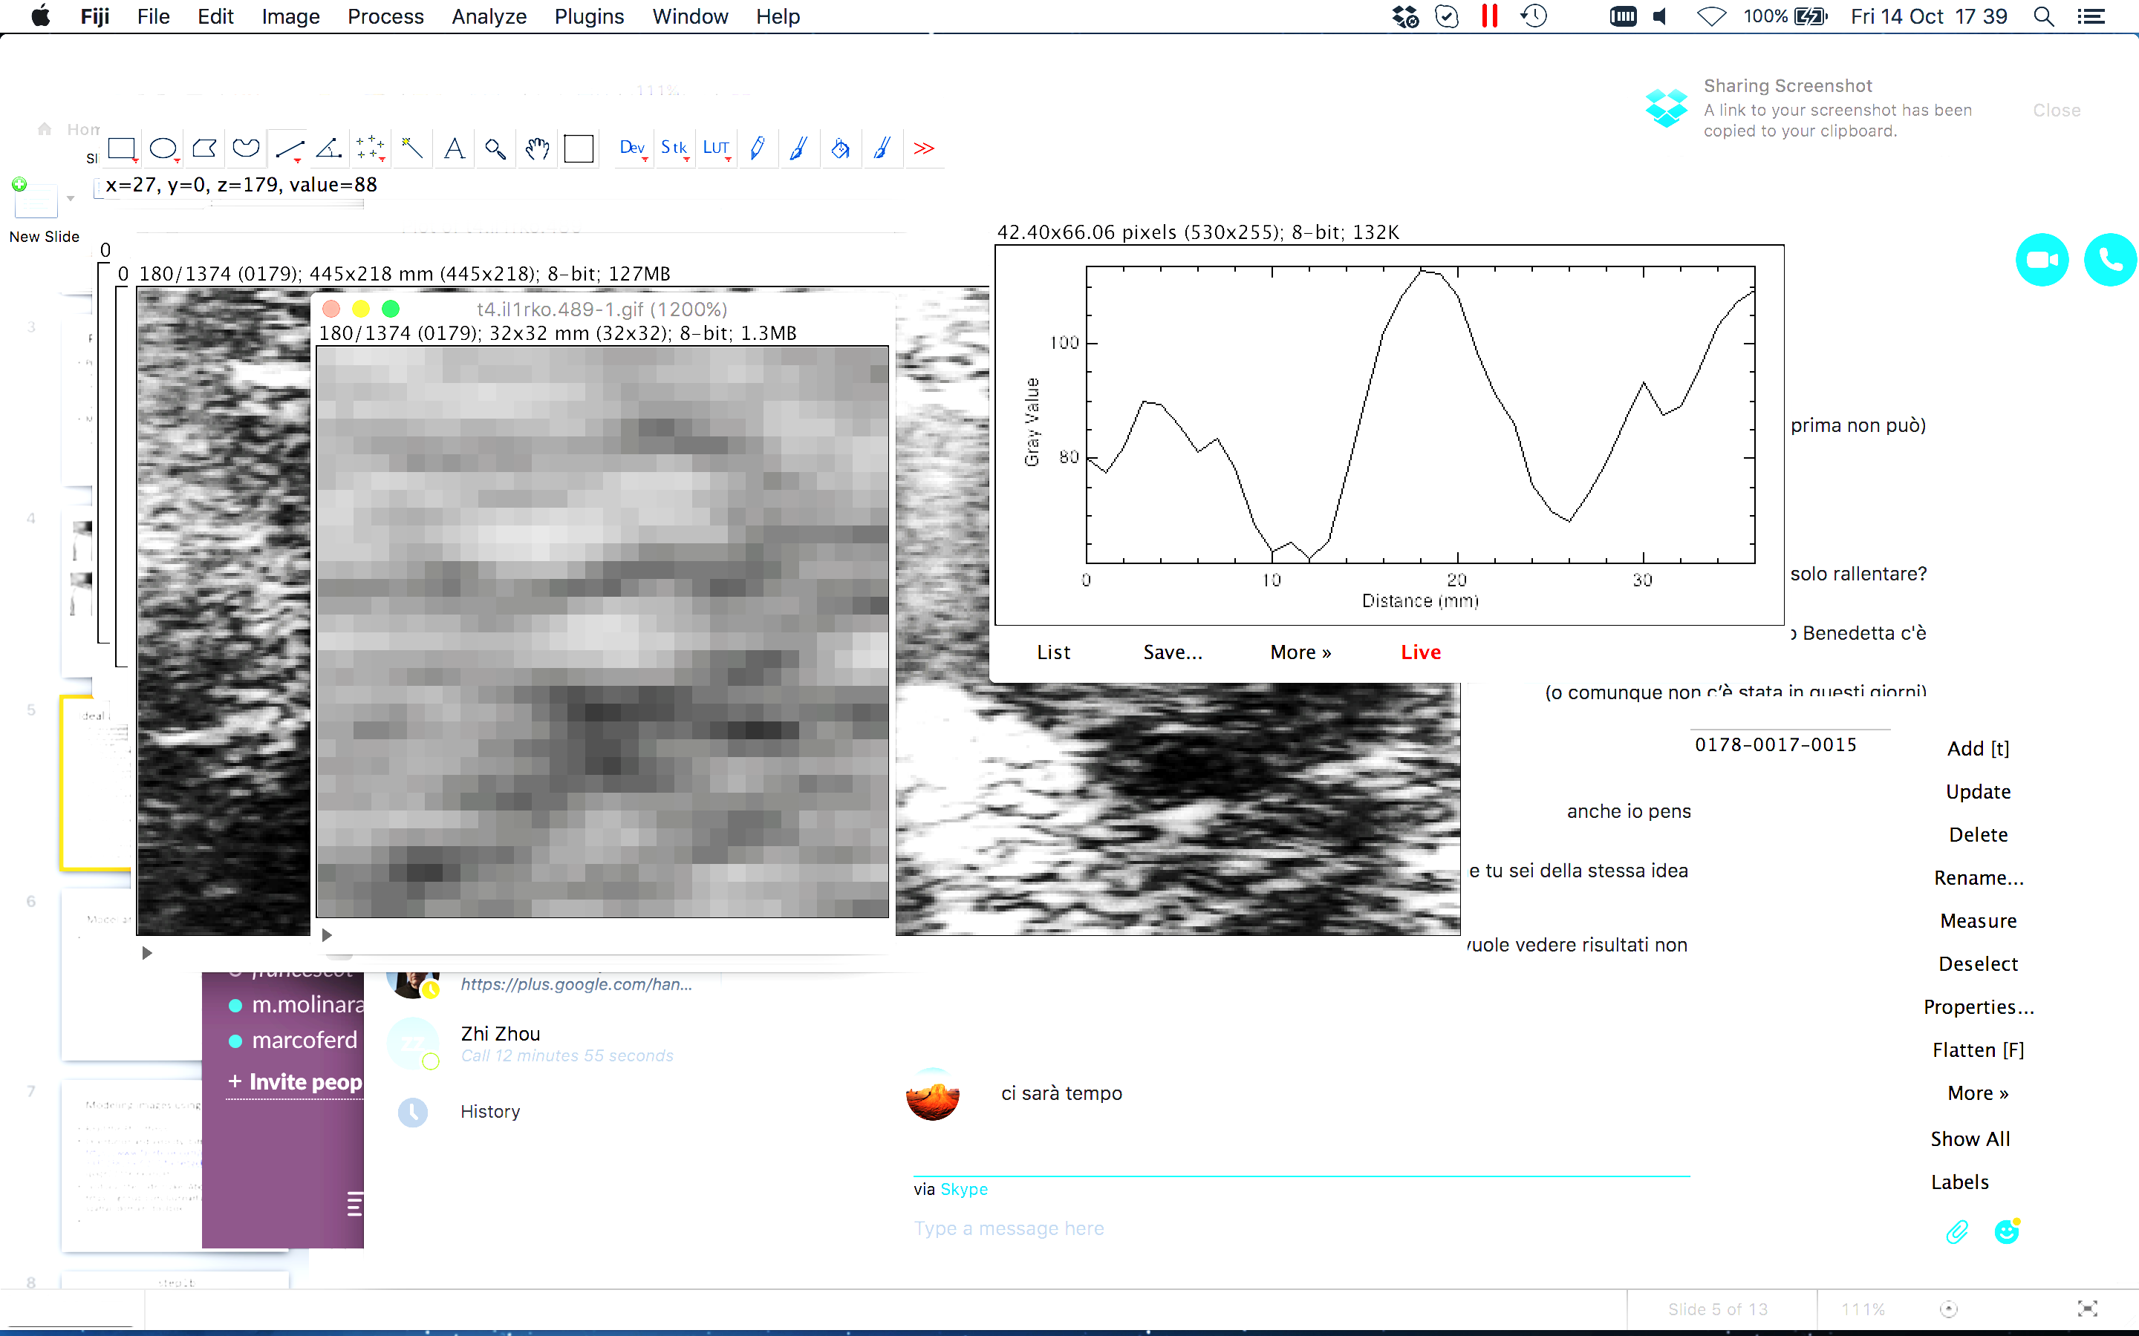
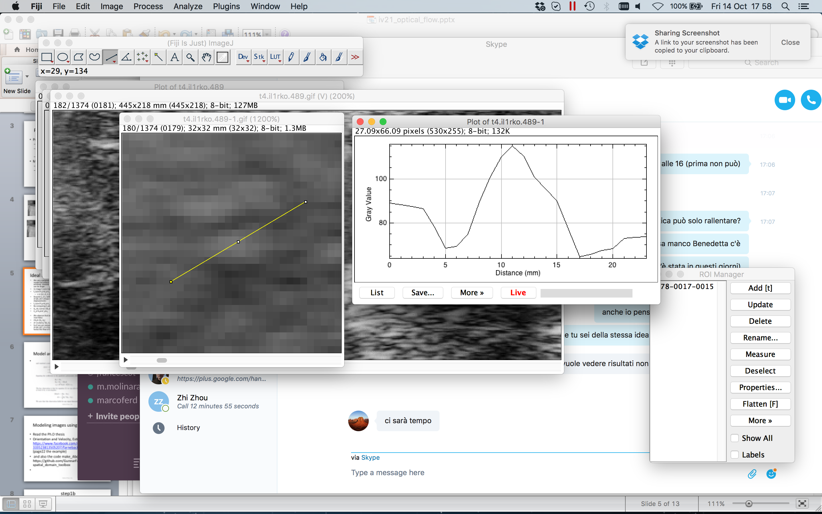
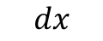
Assumptions
brightness constancy
image intensities do not change significatively although their location may change
spatial coherence
neighboring points belong to the same surface and hence have similar motions
temporal persistence
the image motion of a surface patch changes gradually over time
$$I\left(x,y,t\right)≅I(x+dx, y+dy,t+dt)$$
ultrasound image of aorta
$$x$$
a blood cell
$$x$$
$$dx$$

Slide 7

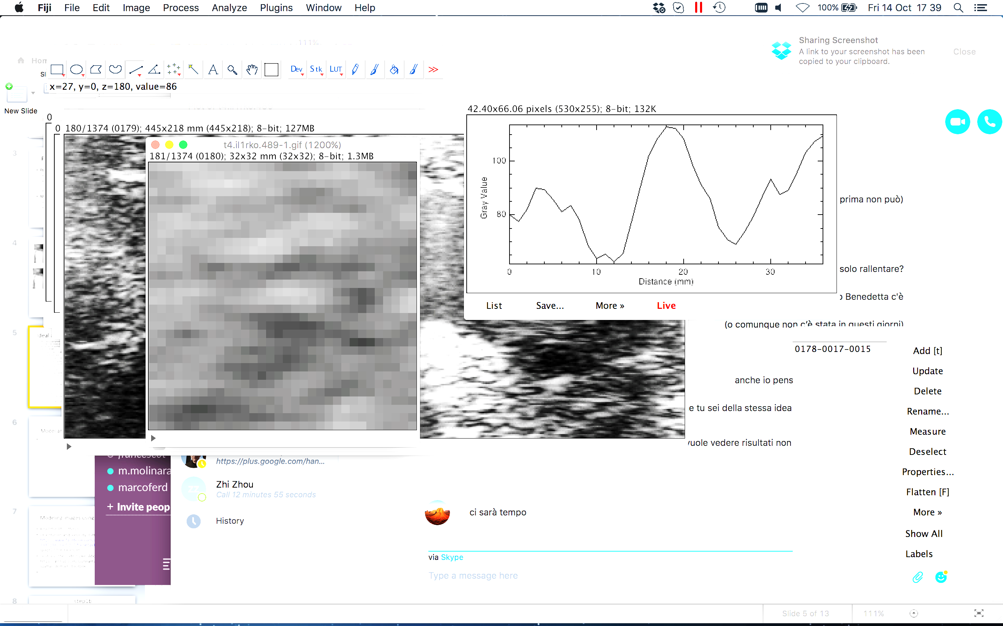

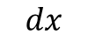
Assumptions
brightness constancy
image intensities do not change significatively although their location may change
spatial coherence
neighboring points belong to the same surface and hence have similar motions
temporal persistence
the image motion of a surface patch changes gradually over time
$$I\left(x,y,t\right)≅I(x+dx, y+dy,t+dt)$$
ultrasound image of aorta
$$x$$
a blood cell
$$x$$
$$dx$$

Slide 8




Assumptions
brightness constancy
image intensities do not change significatively although their location may change
spatial coherence
neighboring points belong to the same surface and hence have similar motions
temporal persistence
the image motion of a surface patch changes gradually over time
$$I\left(x,y,t\right)≅I(x+dx, y+dy,t+dt)$$
ultrasound image of aorta
$$x$$
a blood cell
$$x$$
$$dx$$

Slide 9
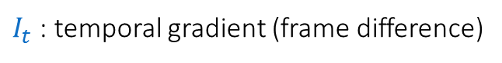
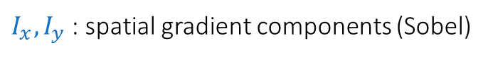
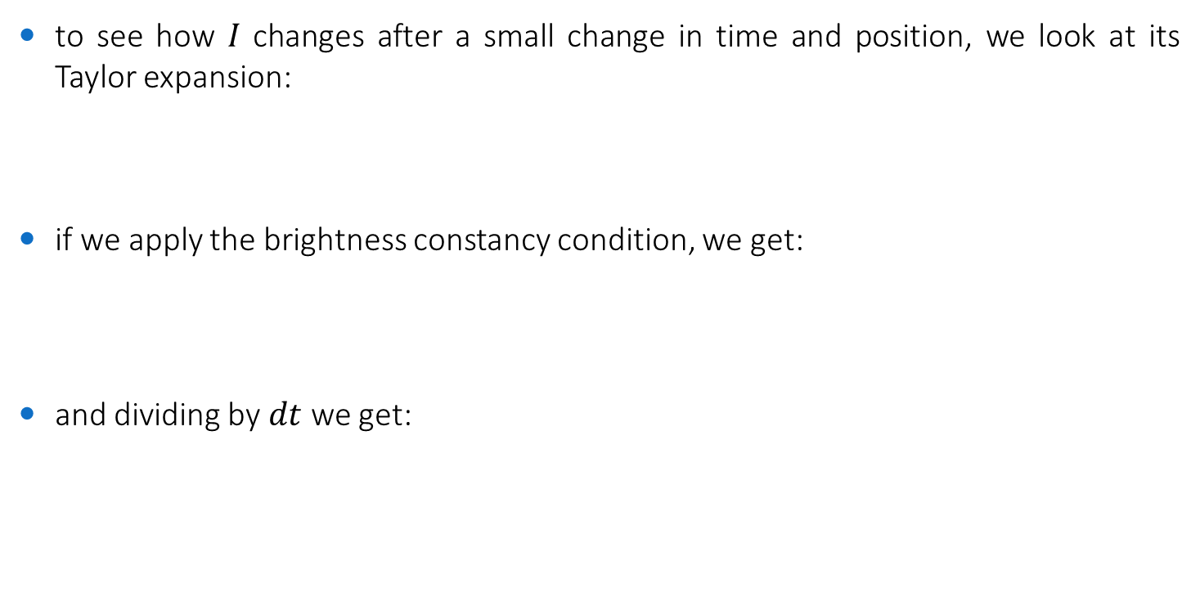
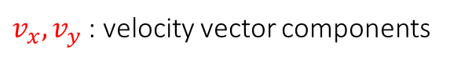
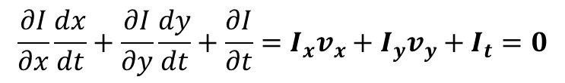
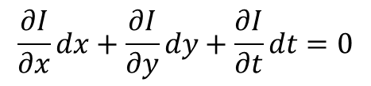
The Optical Flow Equation
to see how 𝐼 changes after a small change in time and position, we look at its Taylor expansion:
if we apply the brightness constancy condition, we get:
and dividing by $dt$ we get:
$$I\left(x+dx, y+dy,t+dt\right)=I\left(x,y,t\right)+\frac{∂I}{∂x}dx+\frac{∂I}{∂y}dy+\frac{∂I}{∂t}dt+ε$$
$$\frac{∂I}{∂x}dx+\frac{∂I}{∂y}dy+\frac{∂I}{∂t}dt=0$$
$v_{x},v_{y}$ : velocity vector components
$$\frac{∂I}{∂x}\frac{dx}{dt}+\frac{∂I}{∂y}\frac{dy}{dt}+\frac{∂I}{∂t}=I_{x}v_{x}+I_{y}v_{y}+I_{t}=0$$
$I_{x},I_{y}$ : spatial gradient components (Sobel)
$I_{t}$ : temporal gradient (frame difference)

Slide 10
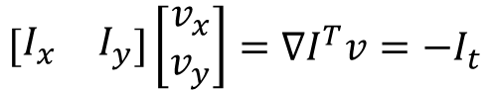
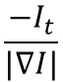
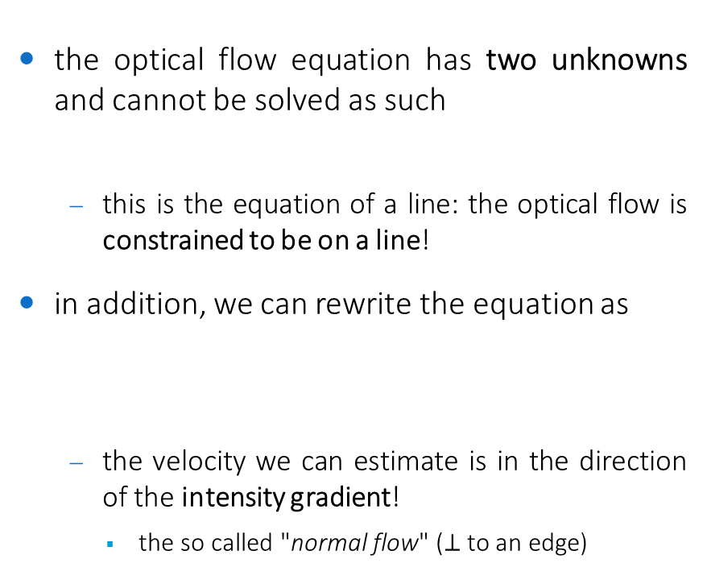
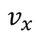
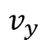
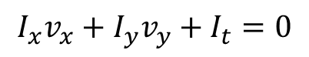
The Aperture Problem
the optical flow equation has two unknowns and cannot be solved as such
this is the equation of a line: the optical flow is constrained to be on a line!
in addition, we can rewrite the equation as
the velocity we can estimate is in the direction of the intensity gradient!
the so called "normal flow" ($⊥$to an edge)
$$I_{x}v_{x}+I_{y}v_{y}+I_{t}=0$$
$$v_{y}$$
normal flow
$$\left[\begin{matrix}I_{x} & I_{y}\end{matrix}\right]\left[\begin{matrix}v_{x} \\ v_{y}\end{matrix}\right]=∇I^{T}v=−I_{t}$$
$$\frac{−I_{t}}{|∇I|}$$
$$v_{x}$$

Slide 11
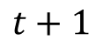
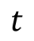
The Aperture Problem (visual interpretation)
estimating the optical flow from one pixel = missing the "whole picture"
the point we are tracking
a moving object
estimated flow
$$t$$
$$t+1$$

Slide 12
The Aperture Problem (visual interpretation)
estimating the optical flow from one pixel = missing the "whole picture"
the point we are tracking
a moving object
true flow
$$t$$
$$t+1$$

Slide 13
Optical Flow Methods
differential methods: based on spatial and temporal image derivatives, but introduce additional conditions to estimate the actual flow
local methods: optimize some local energy-like expression
Lucas-Kanade
global methods: attempt to minimize a global energy functional
Horn-Schunck
phase-based: based on frequency-domain representations
Fleet-Jepson
matching methods: assign labels to (super)pixels and find the deformation that minimizes the distance between the source and the target image
...other methods
Farneback

Slide 14
Lucas-Kanade a sparse optical flow technique

Slide 15
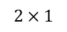
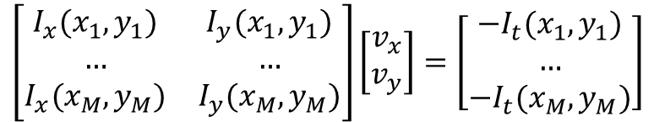
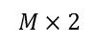
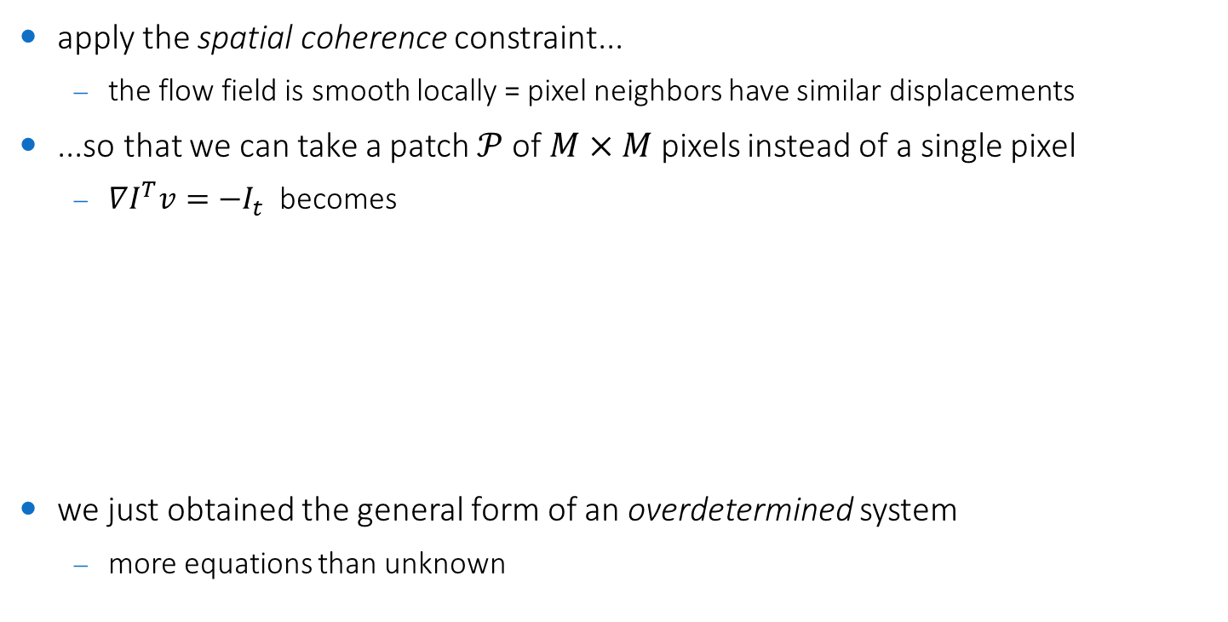
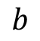
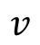
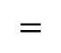
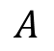
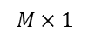
Lucas-Kanade approach (1981)
apply the spatial coherence constraint...
the flow field is smooth locally = pixel neighbors have similar displacements
...so that we can take a patch $𝒫$of $M×M$ pixels instead of a single pixel
$∇I^{T}v=−I_{t}$ becomes
we just obtained the general form of an overdetermined system
more equations than unknown
$$\left[\begin{matrix}I_{x}(x_{1},y_{1}) & I_{y}(x_{1},y_{1}) \\ … & … \\ I_{x}(x_{M},y_{M}) & I_{y}(x_{M},y_{M})\end{matrix}\right]\left[\begin{matrix}v_{x} \\ v_{y}\end{matrix}\right]=\left[\begin{matrix}{−I}_{t}(x_{1},y_{1}) \\ … \\ {−I}_{t}(x_{M},y_{M})\end{matrix}\right]$$
$$A$$
$$v$$
$$=$$
$$b$$
$$M×2$$
$$2×1$$
$$M×1$$

Slide 16
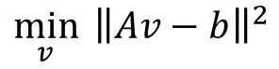
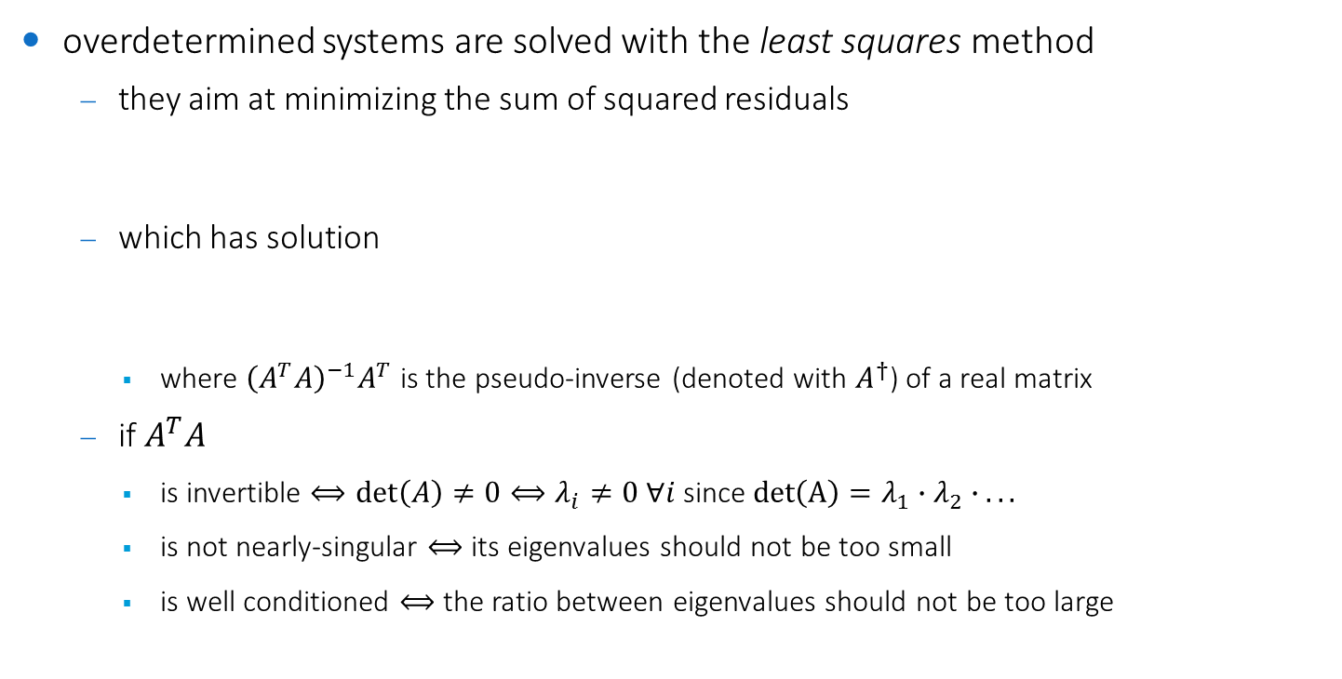
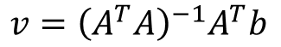
Solving the overdetermined system
overdetermined systems are solved with the least squares method
they aim at minimizing the sum of squared residuals
which has solution
where ${\left(A^{T}A\right)}^{−1}A^{T}$ is the pseudo-inverse (denoted with $A^{†}$) of a real matrix
if $A^{T}A$
is invertible $⟺\det\left(A\right)≠0⟺λ_{i}≠0 ∀i$ since $det\left(A\right)=λ_{1}∙λ_{2}∙ .. .$
is not nearly-singular $⟺$its eigenvalues should not be too small
is well conditioned $⟺$ the ratio between eigenvalues should not be too large
$${\min_{v}{ \left\|Av−b\right\|}}^{2}$$
$$v={\left(A^{T}A\right)}^{−1}A^{T}b$$

Slide 17
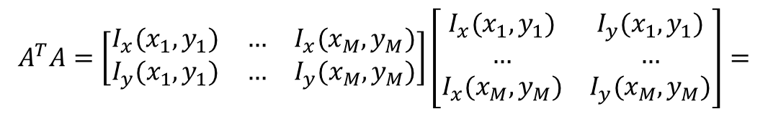
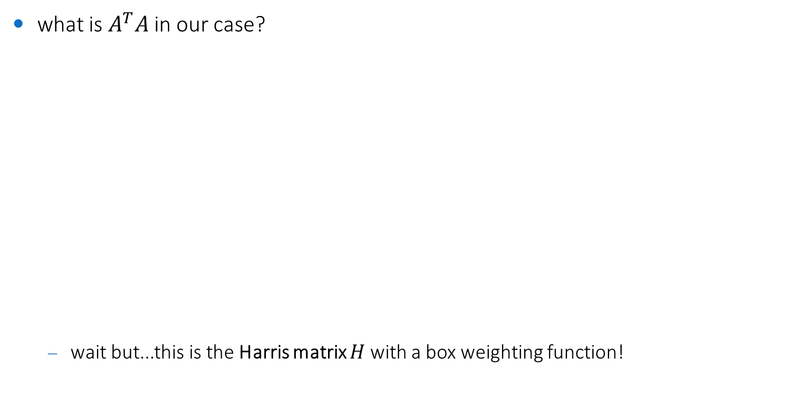
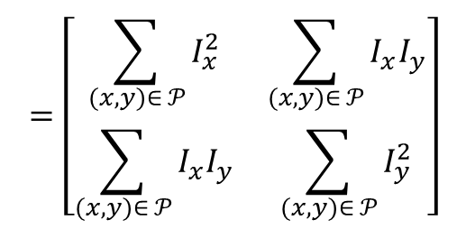
Tie with Harris matrix
what is $A^{T}A$ in our case?
wait but...this is the Harris matrix $H$ with a box weighting function!
$$A^{T}A=\left[\begin{matrix}I_{x}(x_{1},y_{1}) & … & I_{x}(x_{M},y_{M}) \\ I_{y}(x_{1},y_{1}) & … & I_{y}(x_{M},y_{M})\end{matrix}\right]\left[\begin{matrix}I_{x}(x_{1},y_{1}) & I_{y}(x_{1},y_{1}) \\ … & … \\ I_{x}(x_{M},y_{M}) & I_{y}(x_{M},y_{M})\end{matrix}\right]=$$
$$=\left[\begin{matrix}\sum_{(x,y)∈ 𝒫}{I_{x}^{2}} & \sum_{(x,y)∈ 𝒫}{I_{x}I_{y}} \\ \sum_{(x,y)∈ 𝒫}{I_{x}I_{y}} & \sum_{(x,y)∈ 𝒫}{I_{y}^{2}}\end{matrix}\right]$$

Slide 18
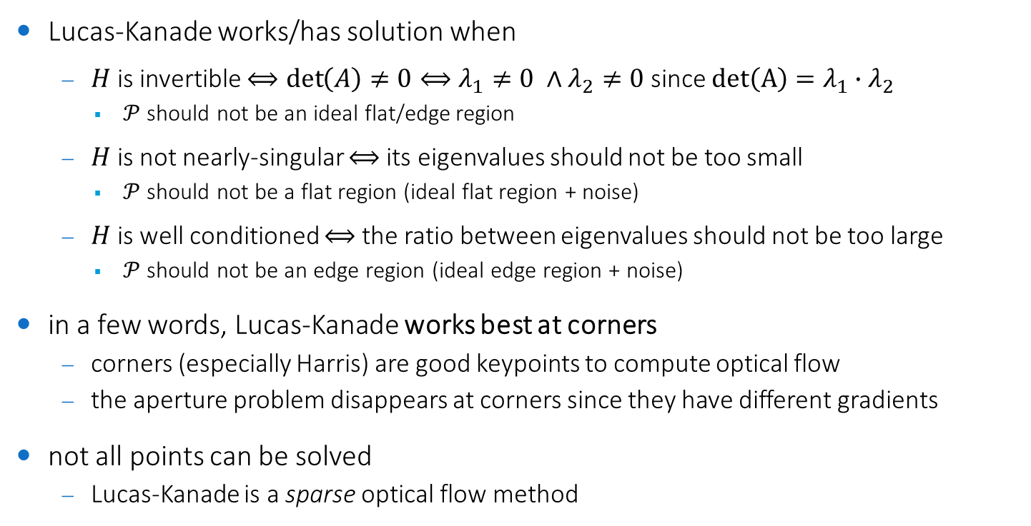
Conditions for solvability
Lucas-Kanade works/has solution when
$H$ is invertible $⟺\det\left(A\right)≠0⟺λ_{1}≠0 ∧λ_{2}≠0$ since $det\left(A\right)=λ_{1}∙λ_{2}$
$𝒫$should not be an ideal flat/edge region
$H$ is not nearly-singular $⟺$its eigenvalues should not be too small
$𝒫$should not be a flat region (ideal flat region + noise)
$H$ is well conditioned $⟺$ the ratio between eigenvalues should not be too large
$𝒫$should not be an edge region (ideal edge region + noise)
in a few words, Lucas-Kanade works best at corners
corners (especially Harris) are good keypoints to compute optical flow
the aperture problem disappears at corners since they have different gradients
not all points can be solved
Lucas-Kanade is a sparse optical flow method

Slide 19
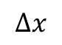
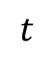
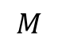





Errors
a point does not move like its neighbors
can be better solved with motion segmentation techniques
brightness constancy does not hold
can be better solved with matching methods
the motion is too large to be detected within the patch $𝒫$ of size $M×M$
$$M$$
$$Δx$$
$$Δx$$
$$t$$
$$t+Δt$$
$$t$$
$$t+Δt$$

Slide 20





Solving the large motion problem (trivial solutions)
reduce $Δt⟺$ increase the framerate
the best solution, but not easy to implement
the framerate depends on the acquisition system
in some cases (e.g. ultrasound images) it can be increased up to a certain limit by adjusting the parameters governing the whole image sequence reconstruction
increase $M$
problem: the larger, the less accurate the corner response
too many gradient contributions
$$M′$$
$$Δx$$
$$t$$
$$t+Δt$$

Slide 21



Solving the large motion problem: improving the accuracy
remember: we started from the brightness constancy condition
and applied the Taylor expansion
where we ignored the higher order terms $ε$
we can rewrite this as a polynomial root finding problem
and solve it with Newton-Raphson method
finds successively better approximations to the roots of a real-valued function
Lukas-Kanade method does one iteration of Newton-Raphson’s method
better results are obtained via more iterations $⇒$ iterative Lucas-Kanade
$$I\left(x,y,t\right)≅I(x+dx, y+dy,t+dt)$$
$$I\left(x+dx, y+dy,t+dt\right)=I\left(x,y,t\right)+I_{x}dx+I_{y}dy+I_{t}dt+ε$$
$$0=I_{x}dx+I_{y}dy+I_{t}dt+ε$$

Slide 22

Iterative Lucas-Kanade
estimate the flow field from a pair of images $I(t−1)$ and $I(t)$
by solving Lucas-Kanade equations
since it is a local method, this will likely produce an estimate of the actual flow field
estimate $≠$ actual
warp $I(t−1)$ towards $I(t)$ using the estimated flow field
based on interpolation
if the estimate is correct, this will likely produce an image $\hat{I}(t)$ which is perfectly overlappable on $I(t)$
but, more likely, $I\left(t\right)$ $≠\hat{I}(t)⇒$ the estimate of the flow field needs refinement
use $\hat{I}(t)$ as $I(t−1)$ and repeat until convergence
i.e. until the flow field is zero or very small

Slide 23

Iterative pyramidal Lucas-Kanade (Bouguet, 2000)
iterative refinement still does not solve the large motion problem
but we can combine it with a coarse-to-fine approach!
build a Gaussian pyramid of $L$ layers
gaussian filtering + downsampling by $2$
start from the highest layer (lower res)
run LK and pass the computed flow field to the lower layer
for each pair of subsequent layers $l+1$ and $l$
upsample the flow field to the resolution of $l$
warp $I^{l}(t−1)$ towards $I^{l}(t)$ using the flow field
run LK between the warped image and $I^{l}(t)$ and refine the estimate of the flow field

Slide 24



Iterative pyramidal Lucas-Kanade (Bouguet, 2000)
run LK
upsample
warp
run LK
upsample
refine
warp
run LK
downsample
upsample
refine
$I∗$gaussian
warp
run LK
pyramid of $I(t−1)$
pyramid of $I(t)$
final result
refine

Slide 25


Exercise 1
apply the pyramidal Lucas-Kanade method in OpenCV to the first video of the licence plate recognition project
detect keypoints using Harris corner detector
track keypoints with Lucas Kanade
when tracked points fall out of the scene, detect new keypoints
draw the trajectory of each keypoint
good optical flow result = straight trajectories
except for relative motions (e.g. wheels relative to the car)
solution in labs/ocv-lucas-kanade.cpp

Slide 26

Farneback a dense optical flow technique

Slide 27



Dense Optical Flow
Lucas-Kanade will only find optical flow at certain points (corners)
sometimes, we need to find optical flow at all pixels
for instance when we need to estimate the motion field
or if we need to analyze the dynamic of the flow (e.g. fluid mechanics)
'dense' optical flow algorithms attempt to solve this problem
Farneback is widely used for very fast dense optical flow estimation

Slide 28





Farneback's approach (2003)
approximate each pixel neighborhood $f\left(x\right)$ by a polynomial where $x={\left(x y\right)}^{T}$
e.g., using a 2nd degree polynomial we get:
where $A$ is a symmetric $2×2$ matrix, $b$ is a $2×1$ vector and $c$ a scalar
how to do that?
the coefficients are estimated in terms of normalized convolution with the basis functions $\{1,x,y,x^{2},y^{2},xy\}$
the relationship between the polynomial expansion and the estimated coefficients is
from which we obtain
for more details, see Farneback's PhD thesis
"Polynomial Expansion for Orientation and Motion Estimation"
$$f\left(x\right)≈x^{T}A x+b^{T}x+c$$
$$\left(\begin{matrix}x & y\end{matrix}\right)A\left(\begin{matrix}x \\ y\end{matrix}\right)+b^{T}\left(\begin{matrix}x \\ y\end{matrix}\right)+c=r_{1}+r_{2}x+r_{3}y+r_{4}x^{2}+r_{5}y^{2}+r_{6}xy$$
$$c=r_{1}$$
$$b=\left(\begin{matrix}r_{2} \\ r_{3}\end{matrix}\right)$$
$$A=\left(\begin{matrix}r_{4} & r_{6} 1/2 \\ r_{6} 1/2 & r_{5}\end{matrix}\right)$$

Slide 29







Farneback's approach (2003)
estimate the global displacement $d$ between the two frames with such approximation
but since the displacement is global, we must have
which yields
and, if $A_{1}$ is not singular, we can estimate $d$ from the second (key) equation
$$f_{1}\left(x\right)≈x^{T}A_{1} x+b_{1}^{T}x+c_{1}$$
$$f_{2}\left(x\right)≈x^{T}A_{2} x+b_{2}^{T}x+c_{2}$$
$$f_{2}\left(x\right)=f_{1}\left(x−d\right)={\left(x−d\right)}^{T}A_{1}\left(x−d\right)+b_{1}^{T}\left(x−d\right)+c_{1}$$
$$=x^{T}A_{1} x+{\left(b_{1}−2A_{1}d\right)}^{T}x+d^{T}A_{1}d−b_{1}^{T}d+c_{1}$$
$$A_{2}=A_{1}$$
$$b_{2}=b_{1}−2A_{1}d$$
$$c_{2}=d^{T}A_{1}d−b_{1}^{T}d+c_{1}$$
$$d=−\frac{1}{2}A_{1}^{−1}(b_{2}−b_{1})$$

Slide 30




Practical considerations
the assumptions about an entire signal being a single polynomial ($A_{1}=A_{2}$) and a global translation $d$ relating the two signals are quite unrealistic
relax the constraint on the single polynomial expansion
instead of using only one approximation for the entire sequence of images, take the average of each pair of frames
relax the constraint on the global translation
replace $d$ with $d(x)$ so it is now a spatially varying displacement field
the key equation now becomes
$$A\left(x\right)=\frac{A_{1}\left(x\right)+A_{2}(x)}{2}$$
$$Δb\left(x\right)=−\frac{1}{2}(b_{2}\left(x\right)−b_{1}(x))$$
$$A\left(x\right)d\left(x\right)=Δb(x)$$
where

Slide 31



Estimation over a neighborhood
the key equation could be solved pointwise, but in practice it yields noisy results
solution: average information over a neighborhood $𝒫$ (spatial coherence)
this yields an overdetermined system, so the goal becomes to minimize
with $w(∙)$ being a weight function (e.g. Gaussian) for the points in the neighborhood
which has solution (remember the least squares problem)
where ${\left(A^{T}WA\right)}^{−1}A^{T}W$ is a.k.a. the weighted pseudo-inverse
$$\sum_{Δx∈𝒫}{w\left(Δx\right){\left\|A\left(x+Δx\right)d\left(x\right)−Δb(x+Δx)\right\|}^{2}}$$
$$d\left(x\right)={\left(\sum{wA^{T}A}\right)}^{−1}\sum{wA^{T}Δb= {\left(A^{T}WA\right)}^{−1}A^{T}Wb}$$

Slide 32
Other improvements/modifications
the robustness of the approach can be improved if the displacement field is parameterized according to some motion model
e.g. an affine model (translations + rotations + scalings)
incorporating a priori knowledge
e.g. when the motion is large, we can input an estimate of the largest component of the motion and Farneback will refine it
iterative and multi-scale displacement estimation
similar to Lucas-Kanade, based on image pyramids

Slide 33


Exercise 2
apply Farneback to an image sequence where it is possible to detect the motion of objects
smoothing / median filtering could help both as pre-processing (of the image) and post-processing (of the motion field)
in some applications it also helps to smooth the computed flow field along the temporal axis (spatio-temporal smoothing)
the result should be visualized using HSV color coding (H = direction, S = magnitude)
solution in labs/ocv-farneback.cpp

Slide 34

Exercise 3
track the motion in this GIF video sequence:

